Slide 1
Alma: The Beauty of Vienna
By: Hannah Butterfield, Rachel Patel, Ricardo Martinez

Slide 2
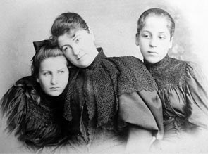
Alma
Born in 1879 to Emil Jakob Schindler and Anna Sophie Bergen
Alma’s father died in 1892
Alma with her mother and half-sister

Slide 3
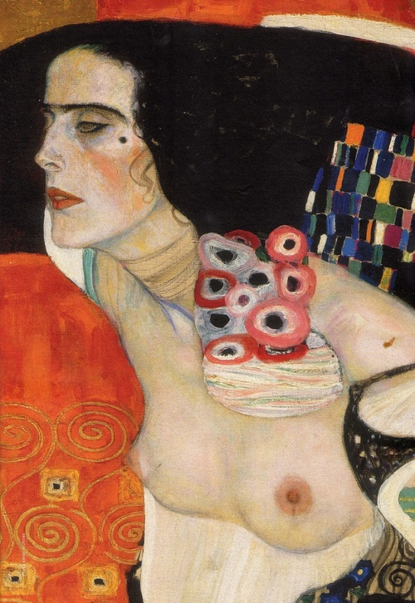
Klimt’s Alma
“My soul thrills to him, I desire him with every fibre of my body. I long for him as for a savior, a deliverer, my only redeemer!”
(Alma’s Diary, 244)

Slide 4
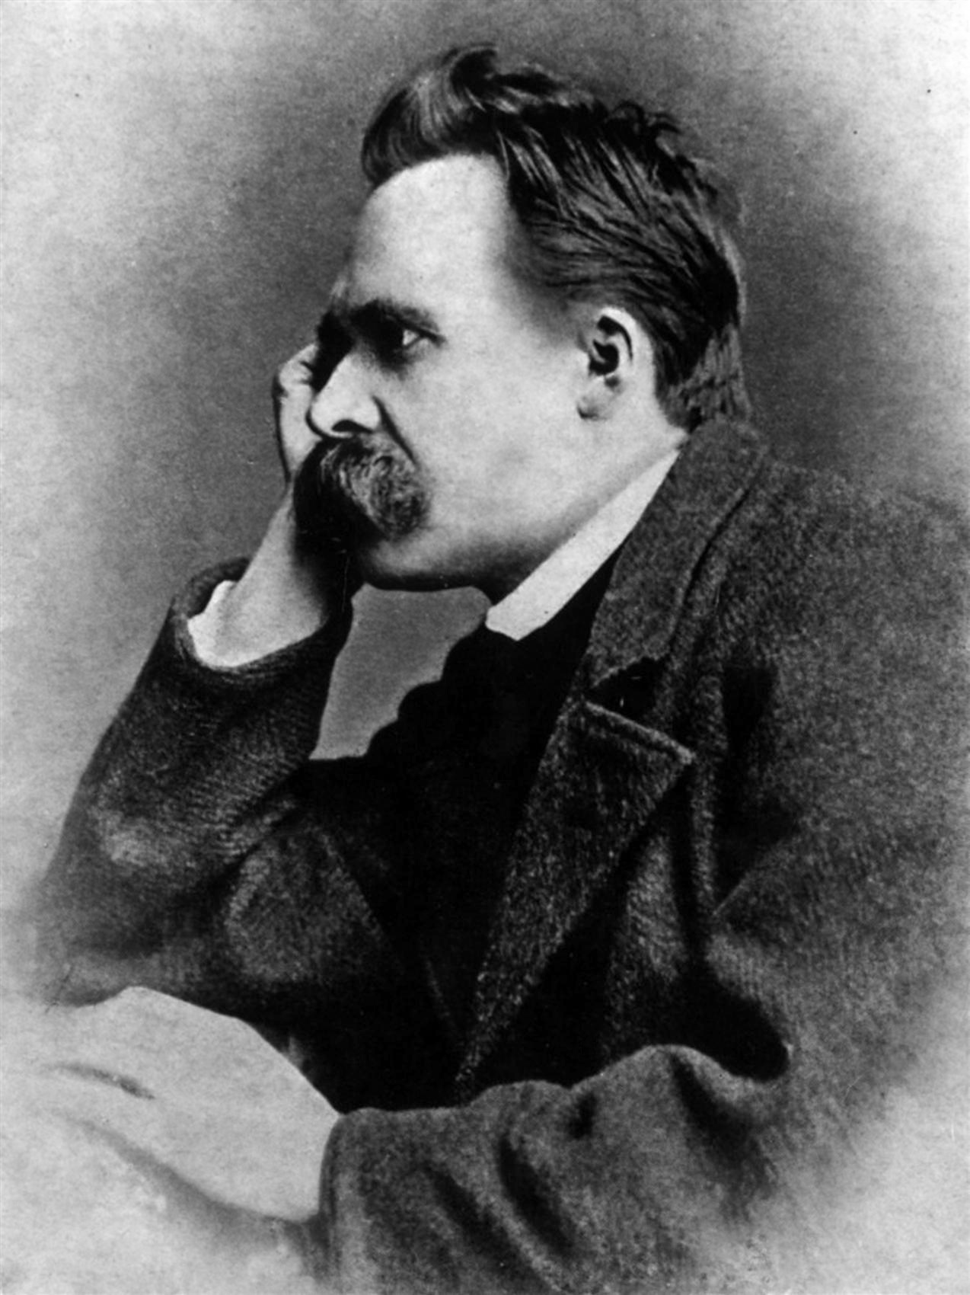
Nietzsche – Alma’s Influencer

Slide 5
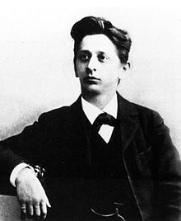
Zemlinsky
“A caricature – chinless, small, with bulging eyes and a maniacal way of conducting, yet he pleased me exceptionally.”

Slide 6
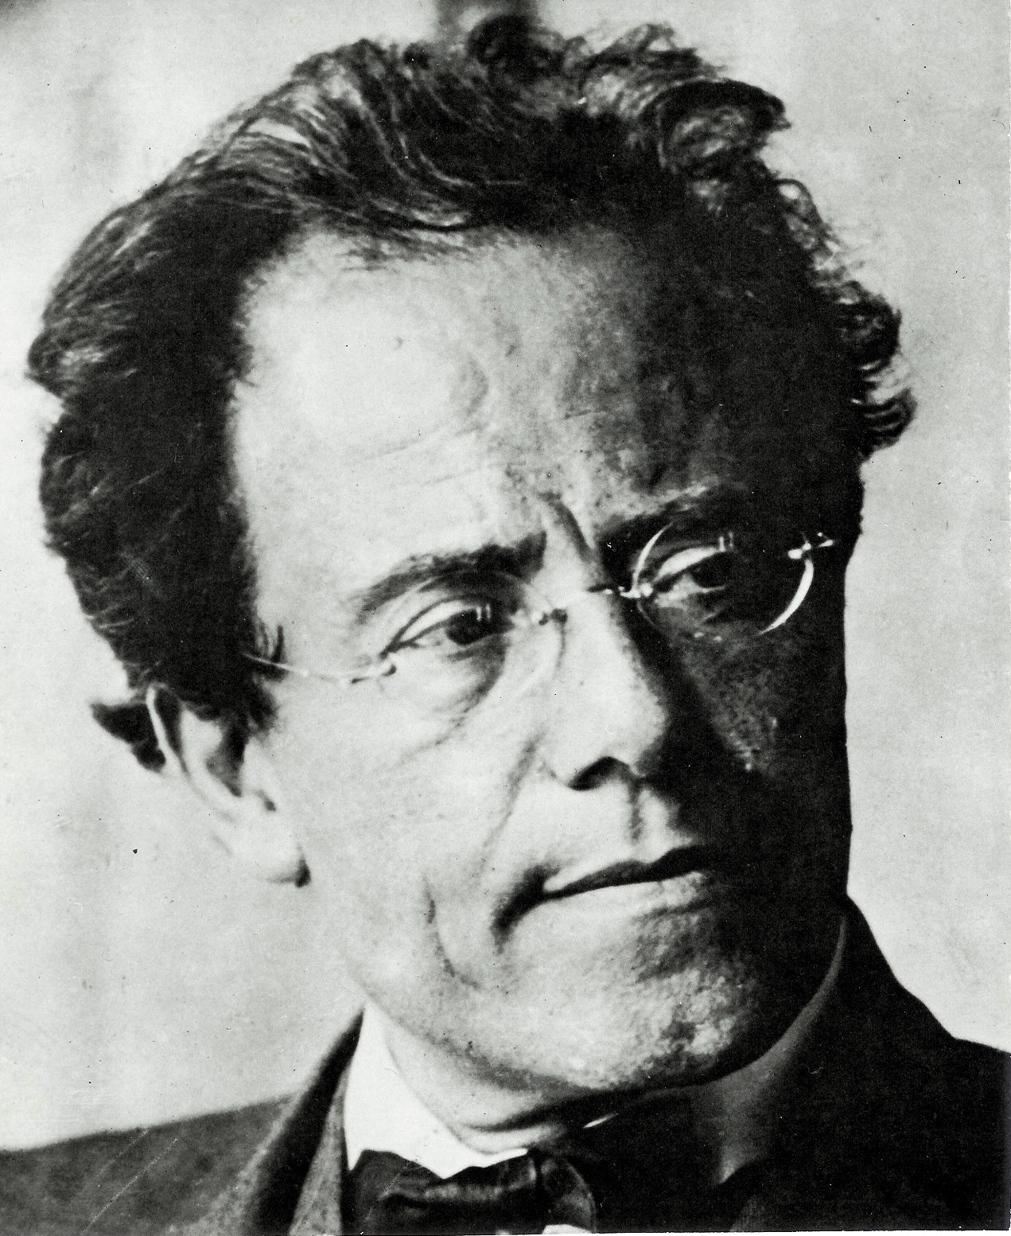
Gustav Mahler
“And his art leaves me cold, so dreadfully cold. In plain words: I don’t believe in him as a composer. And I’m expected to bind my life to this man… I felt nearer to him from a distance than from near by.” (Alma’s Diary, 449)

Slide 7
Alma’s Dilemma
“I’m on the horns of a terrible dilemma. I keep repeating the words ‘my beloved’ and follow them with ‘Alex’ (Alexander Zemlinsky). Can I really love Mahler as he deserves and as I am really able? Shall I ever understand his art, and he mine!? With Alex the sympathy is mutual. He loves every note of me.” (Alma’s Diary, 448)

Slide 8
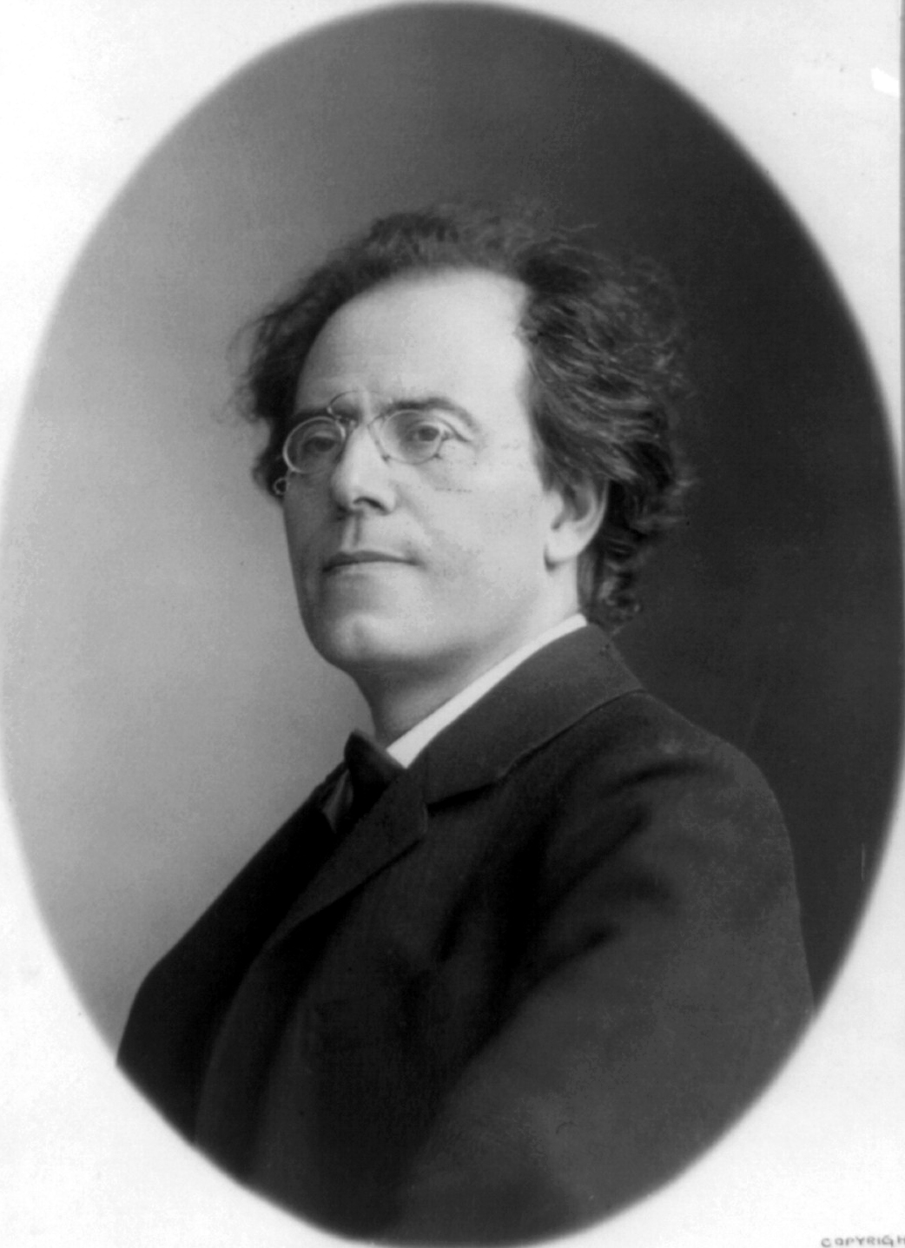
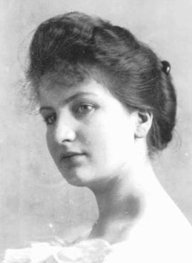
Alma-Mahler
“This morning I reread his letter – and suddenly I felt such warmth. What if I were to renounce (my music) out of love for him?... I must live entirely for him, to make him happy.” (Alma’s Diary, 462)

Slide 9
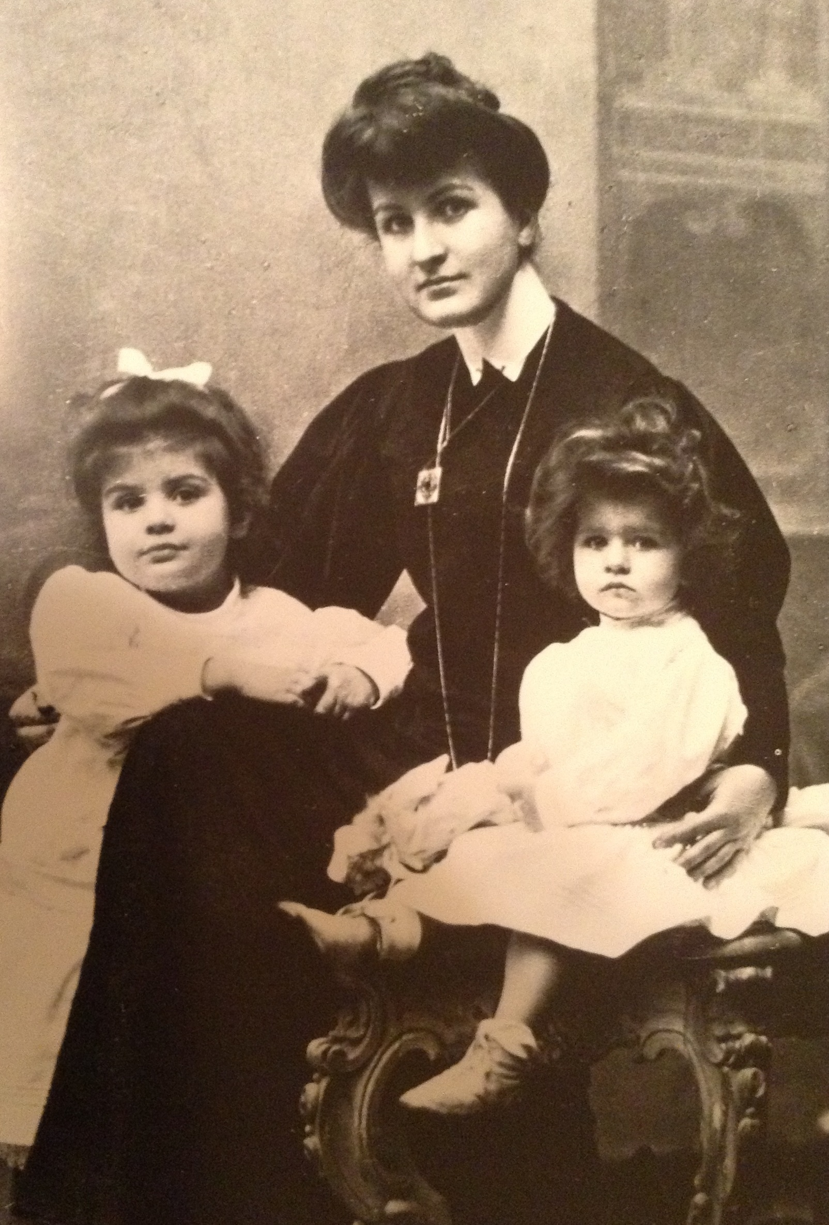
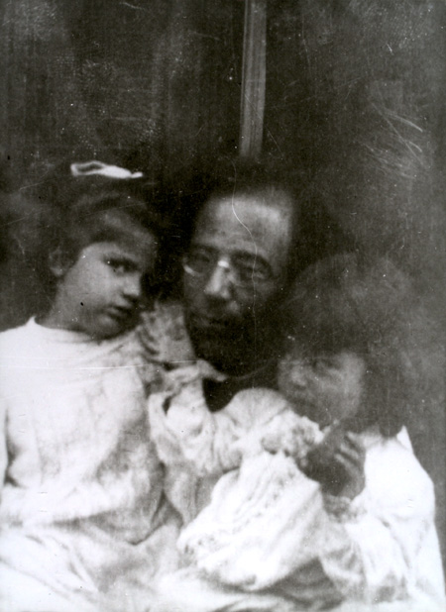
Alma and Mahler with their daughters

Slide 10
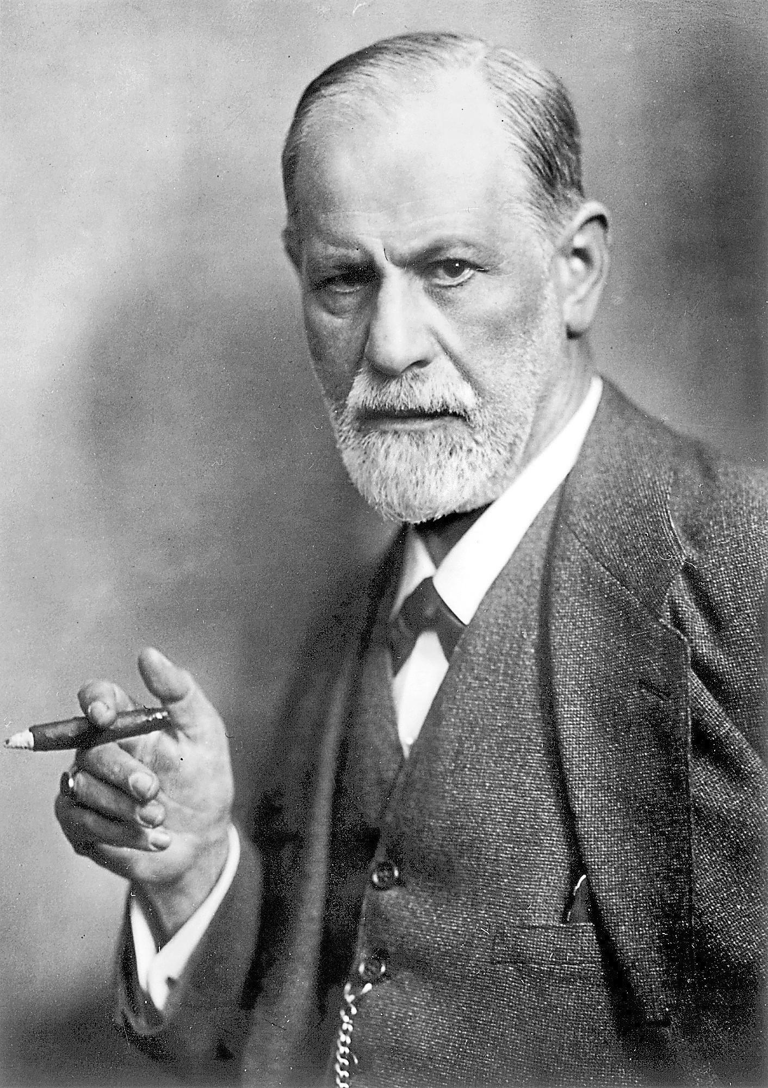
Freud
Proposed the Oedipus Complex as the problem

Slide 11
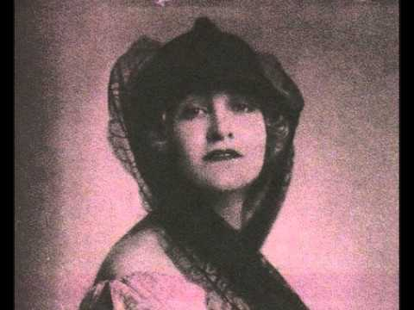
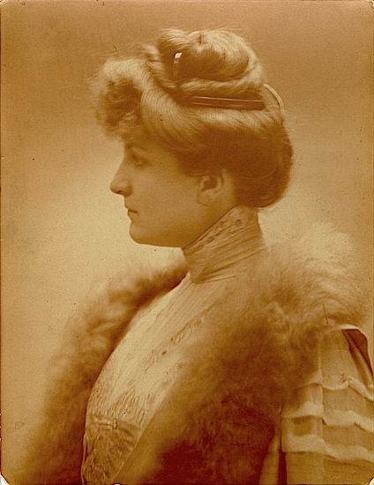
The “Alma Problem”
“Whoever falls, should also be given a push!” - Nietzsche

Slide 12
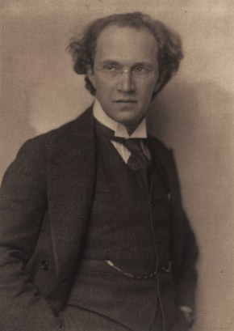
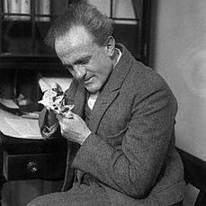
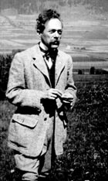
After the Death of Mahler…
Joseph Fraenkel (Doctor)
Franz Schreker (Composer)
Paul Kammerer (Biologist)

Slide 13
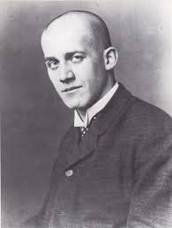
Oskar Kokoschka (1912 – 1915)
“How beautiful she was, how seductive behind her mourning veil! I was bewitched by her!” (Kokoschka, 1912)

Slide 14
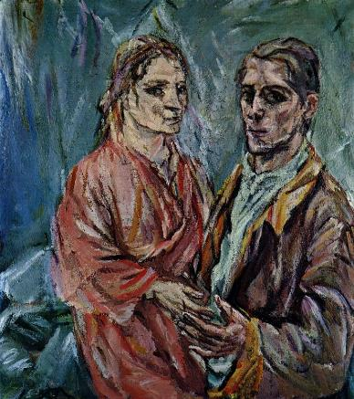
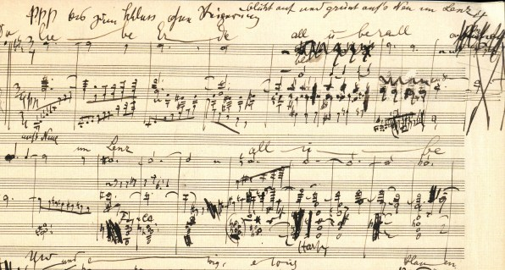
Jealousy and Love
Arguments included his jealousy over Gustav Mahler…
Mahler’s 9th Symphony
Double Portrait Oskar Kokoschka and Alma Mahler

Slide 15
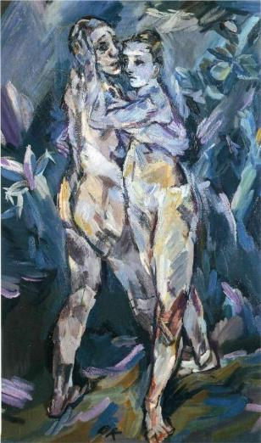
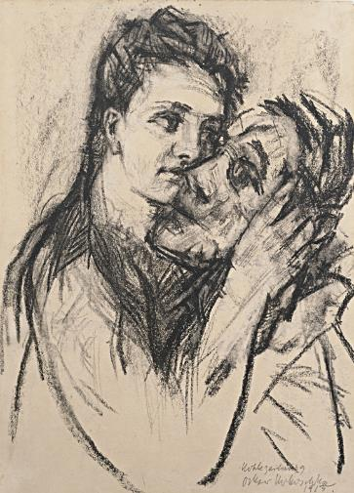
Oskar and Alma
Two Nudes (1913)
Alma Mahler and Oskar Kokoschka

Slide 16
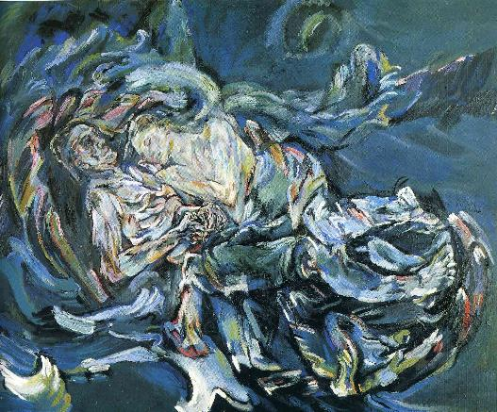
“Bride of the Wind” 1913
"In my Bride of the Wind, we are united for eternity.“
(Kokoschka)

Slide 17
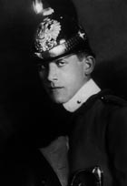
Oskar Kokoschka: Dec. 1914
Oskar Kokoschka was recruited into the most elite Calvary Regiment.

Slide 18
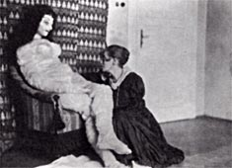
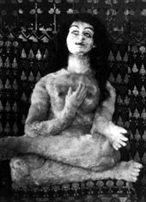
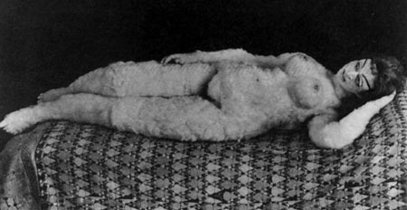
Alma Mahler - Doll

Slide 19
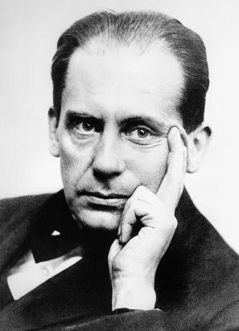
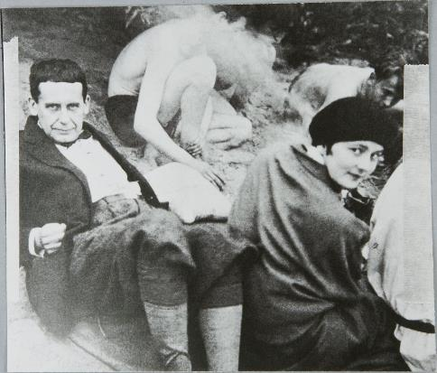
Alma Mahler and Walter Gropius (1915 – 1920)

Slide 20
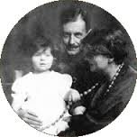
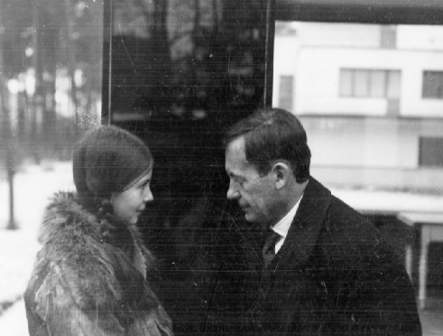
Alma, Walter and Manon Gropius
Walter Gropius and Manon Alma Anna Justine Caroline Gropius (1916 – 1935)

Slide 21
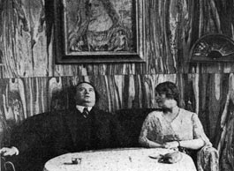
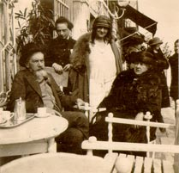
Alma at her salon in Elisabethenstrasse
Franz Werfel at Alma’s Salon

Slide 22
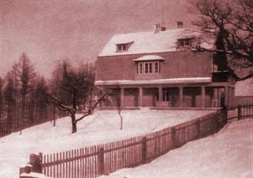
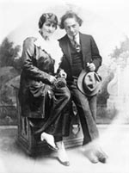
Werfel’s Child or Gropius’s?
Alma’s house in Breitenstein (top)
Alma and Franz Werfel (right)

Slide 23
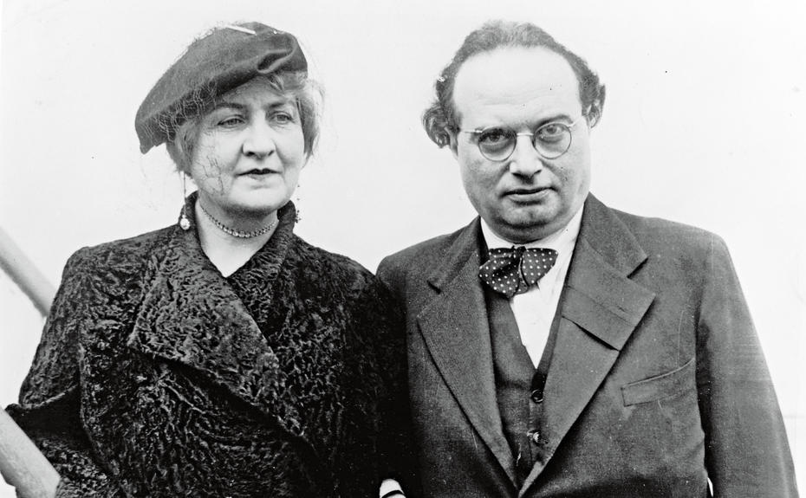
Alma and Werfel
Franz met Alma at her salon.

Slide 24
Who was Franz Werfel?
He was a Jewish novelist, play writer, and poet

Slide 25
Johannes Hollnsteiner
-While married to Franz she had an affair with Johannes.

Slide 26
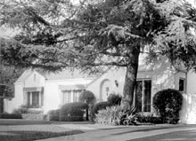
Alma’s exit from Vienna
1938 Alma and Franz were forced to leave Vienna
Spring of 1940 they were no long safe in France, so they emigrated to United States

Slide 27
Death of Franz Werfel
-Although they were still married during Werfel’s death Alma did not show up to his funeral.

Slide 28
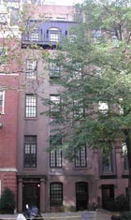
Rich Widow Again
- In 1951 Alma moved back New York
- Alma became rich from royalties from Werfel’s publication and profit from extensive writings he left behind.

Slide 29
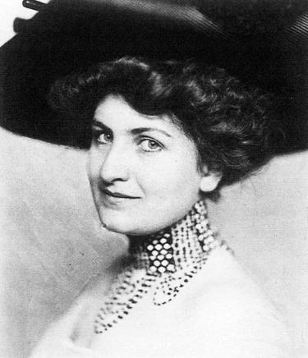
The End of Alma Mahler
On December 11, 1964 Alma Mahler-Werfel died at the age of 85

Slide 30
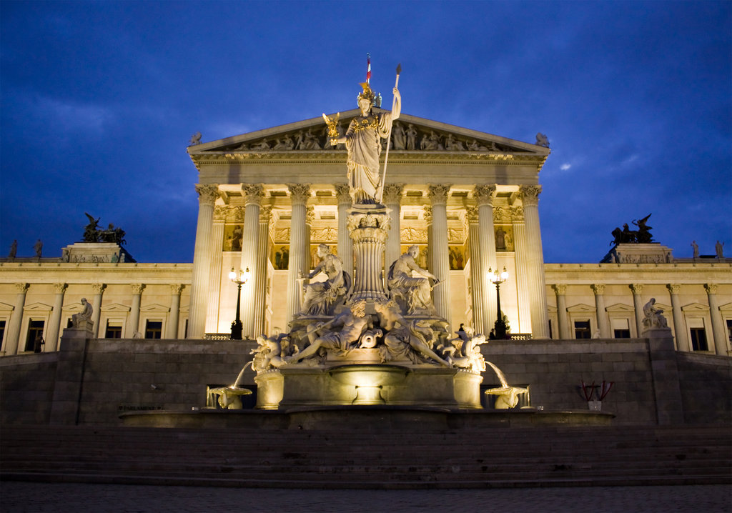
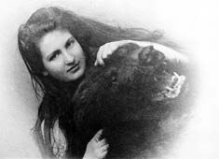
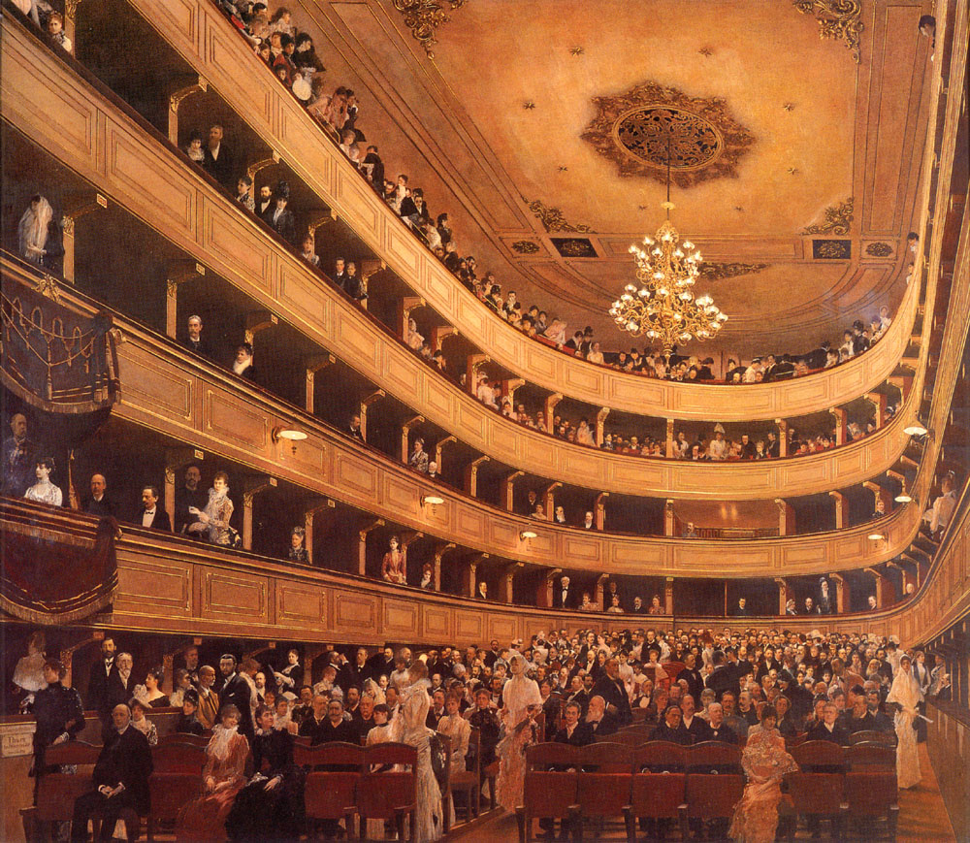
Alma – The Beauty of Vienna

Slide 31
Alma Lives On
Shortly after Alma’s death Tom Lehrer Wrote a song called “Alma”
https://www.youtube.com/watch?v=hH4J8CIBc7Q

