Slide 1
Ringstrasse
Vienna

Slide 2
To explore
https://www.youtube.com/watch?t=49&v=V5Fme4BZyAQ
http://ringview.vienna.info/en

Slide 3
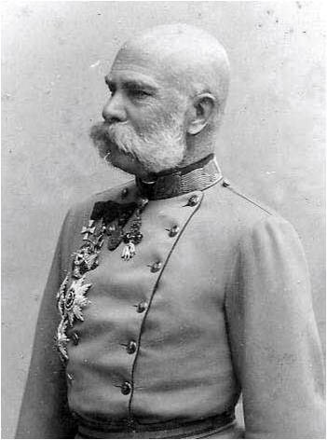
Franz-Joseph
„It is my will that the expansion of the city of Vienna take place with attention to a proper connection of the city to its suburbs.”
Franz-Joseph, Christmas Day, 1857
Notes:
“Es ist mein Wille, dass die Erweiterung der Inneren Stadt Wien mit Rücksicht auf eine entsprechende Verbindung derselben mit den Vorstädten ehemöglichst in Angriff genommen werde”,
Franz Joseph, 25. Dezember 1857

Slide 4
Vienna 1800

Slide 5
Vienna 1850

Slide 6
Vienna 1870

Slide 7
Vienna 1900

Slide 8
c. 1870

Slide 9
Promenade c. 1890
Notes:
Who are these people

Slide 10
Votivkirche

Slide 11
Chronology of the Ringstrasse
Early phase. First buildings: Ecclesiastical and military (the rule of sabre and religion)
Votivkirche
Barracks for three regiments
The street itself
Then, after military defeats in 1859 and 1866: centers of constitutional government and higher culture
Reichsrat (Parliament)
Universität
Burgtheater (Court theater)

Slide 12
Reichsrat c. 1900

Slide 13
Universität 1900

Slide 14
Burgtheater, c. 1900

Slide 15
Hofoper c. 1900

Slide 16
Hofoper 1902

Slide 17
Stilarchtektur
“Style archtecture”: each building was designed in the style of a bygone era, an era consistent in the view of the builders with the function of the building

Slide 18
Mietpalais

Slide 19
Schwarzenbergplatz

